Slide 1

CEIR Check IMEI Feature -Training Manual

Slide 2

Agenda
Feature
Stakeholder
State Diagram
UI Walk Thru
Check IMEI
Valid Device
Invalid Device

Slide 3

Feature Overview
Check IMEI Feature allows end user check the IMEI to ensure the validity of device.
End user or stakeholder can check the IMEI
Typical flow is as follows:
End User / Stakeholder
Check IMEI Device
End user check IMEI details in the CEIR portal
CEIR system check IMEI and respond ba
CEIR System

Slide 4
Feature Impact / Use Cases
Importance of this feature for the CEIR System
This create lot of goodwill about the whole CEIR program where end user will see a value that they can check the status of their device before buying devices

Slide 5
Stakeholder Overview

Slide 6
Check Visa - Flow
Key Points
Policy is defined as per period (grace and post grace)
Feature can be enabled or disabled based on period
Check IMEI
Enter Device Type and Device ID
Apply each Policy as per period
Check
All policy
result
Pass
Return Valid device
Fail
Return invalid device with reason

Slide 7
Check IMEI - User Flow
End User want to check IMEI.
In order to check IMEI details , a End User needs to furnish the following details:
Device ID Type (IMEI, MEID)
Device ID (IMEI value)
System process the request and apply the policy as defined in the system.
If the policy execution are successful, then the device status will be set as VALID
If any one of the policy fails, the status would be set as INVALID with reason.

Slide 8
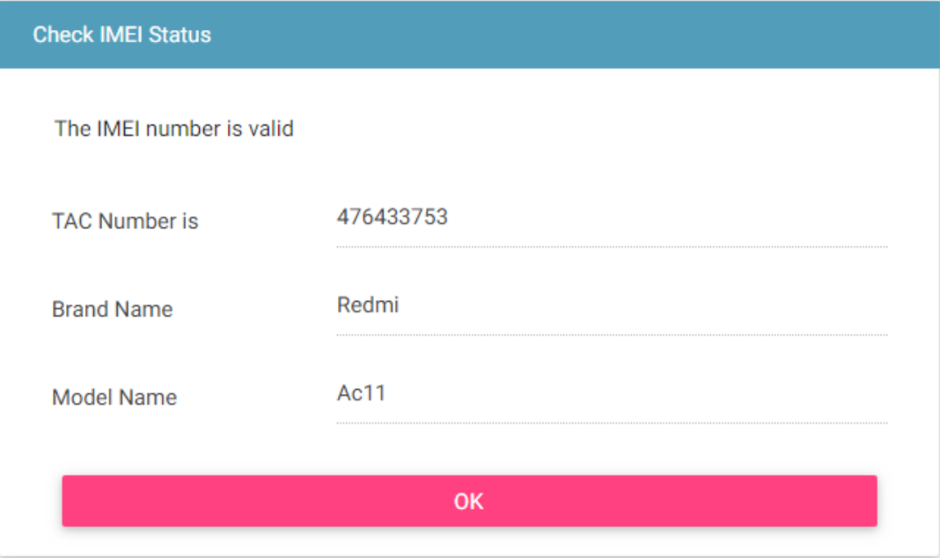
Check IMEI – Valid Case

Slide 9
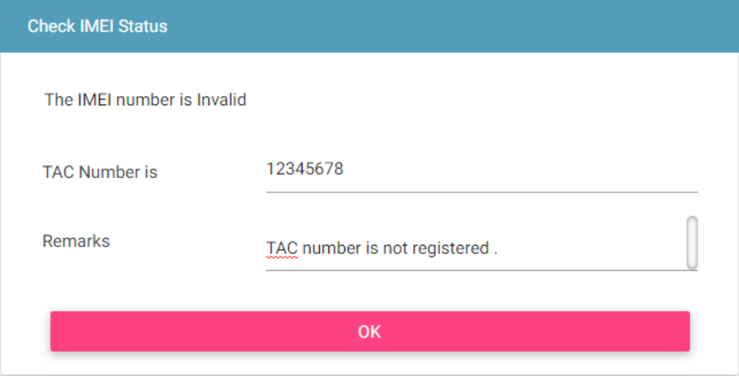
Check IMEI – In-Valid Case

Slide 10
Policy
Policy for grace and post grace period can be same or different for check IMEI
This feature should be launched/enabled, once the data related to policy execution is build up in the system
This feature has dependency on TAC database.
More details on same would be discussed in the “Policy Management” Training session

Slide 11
Queries

Slide 12
Thank You

